Slide 1
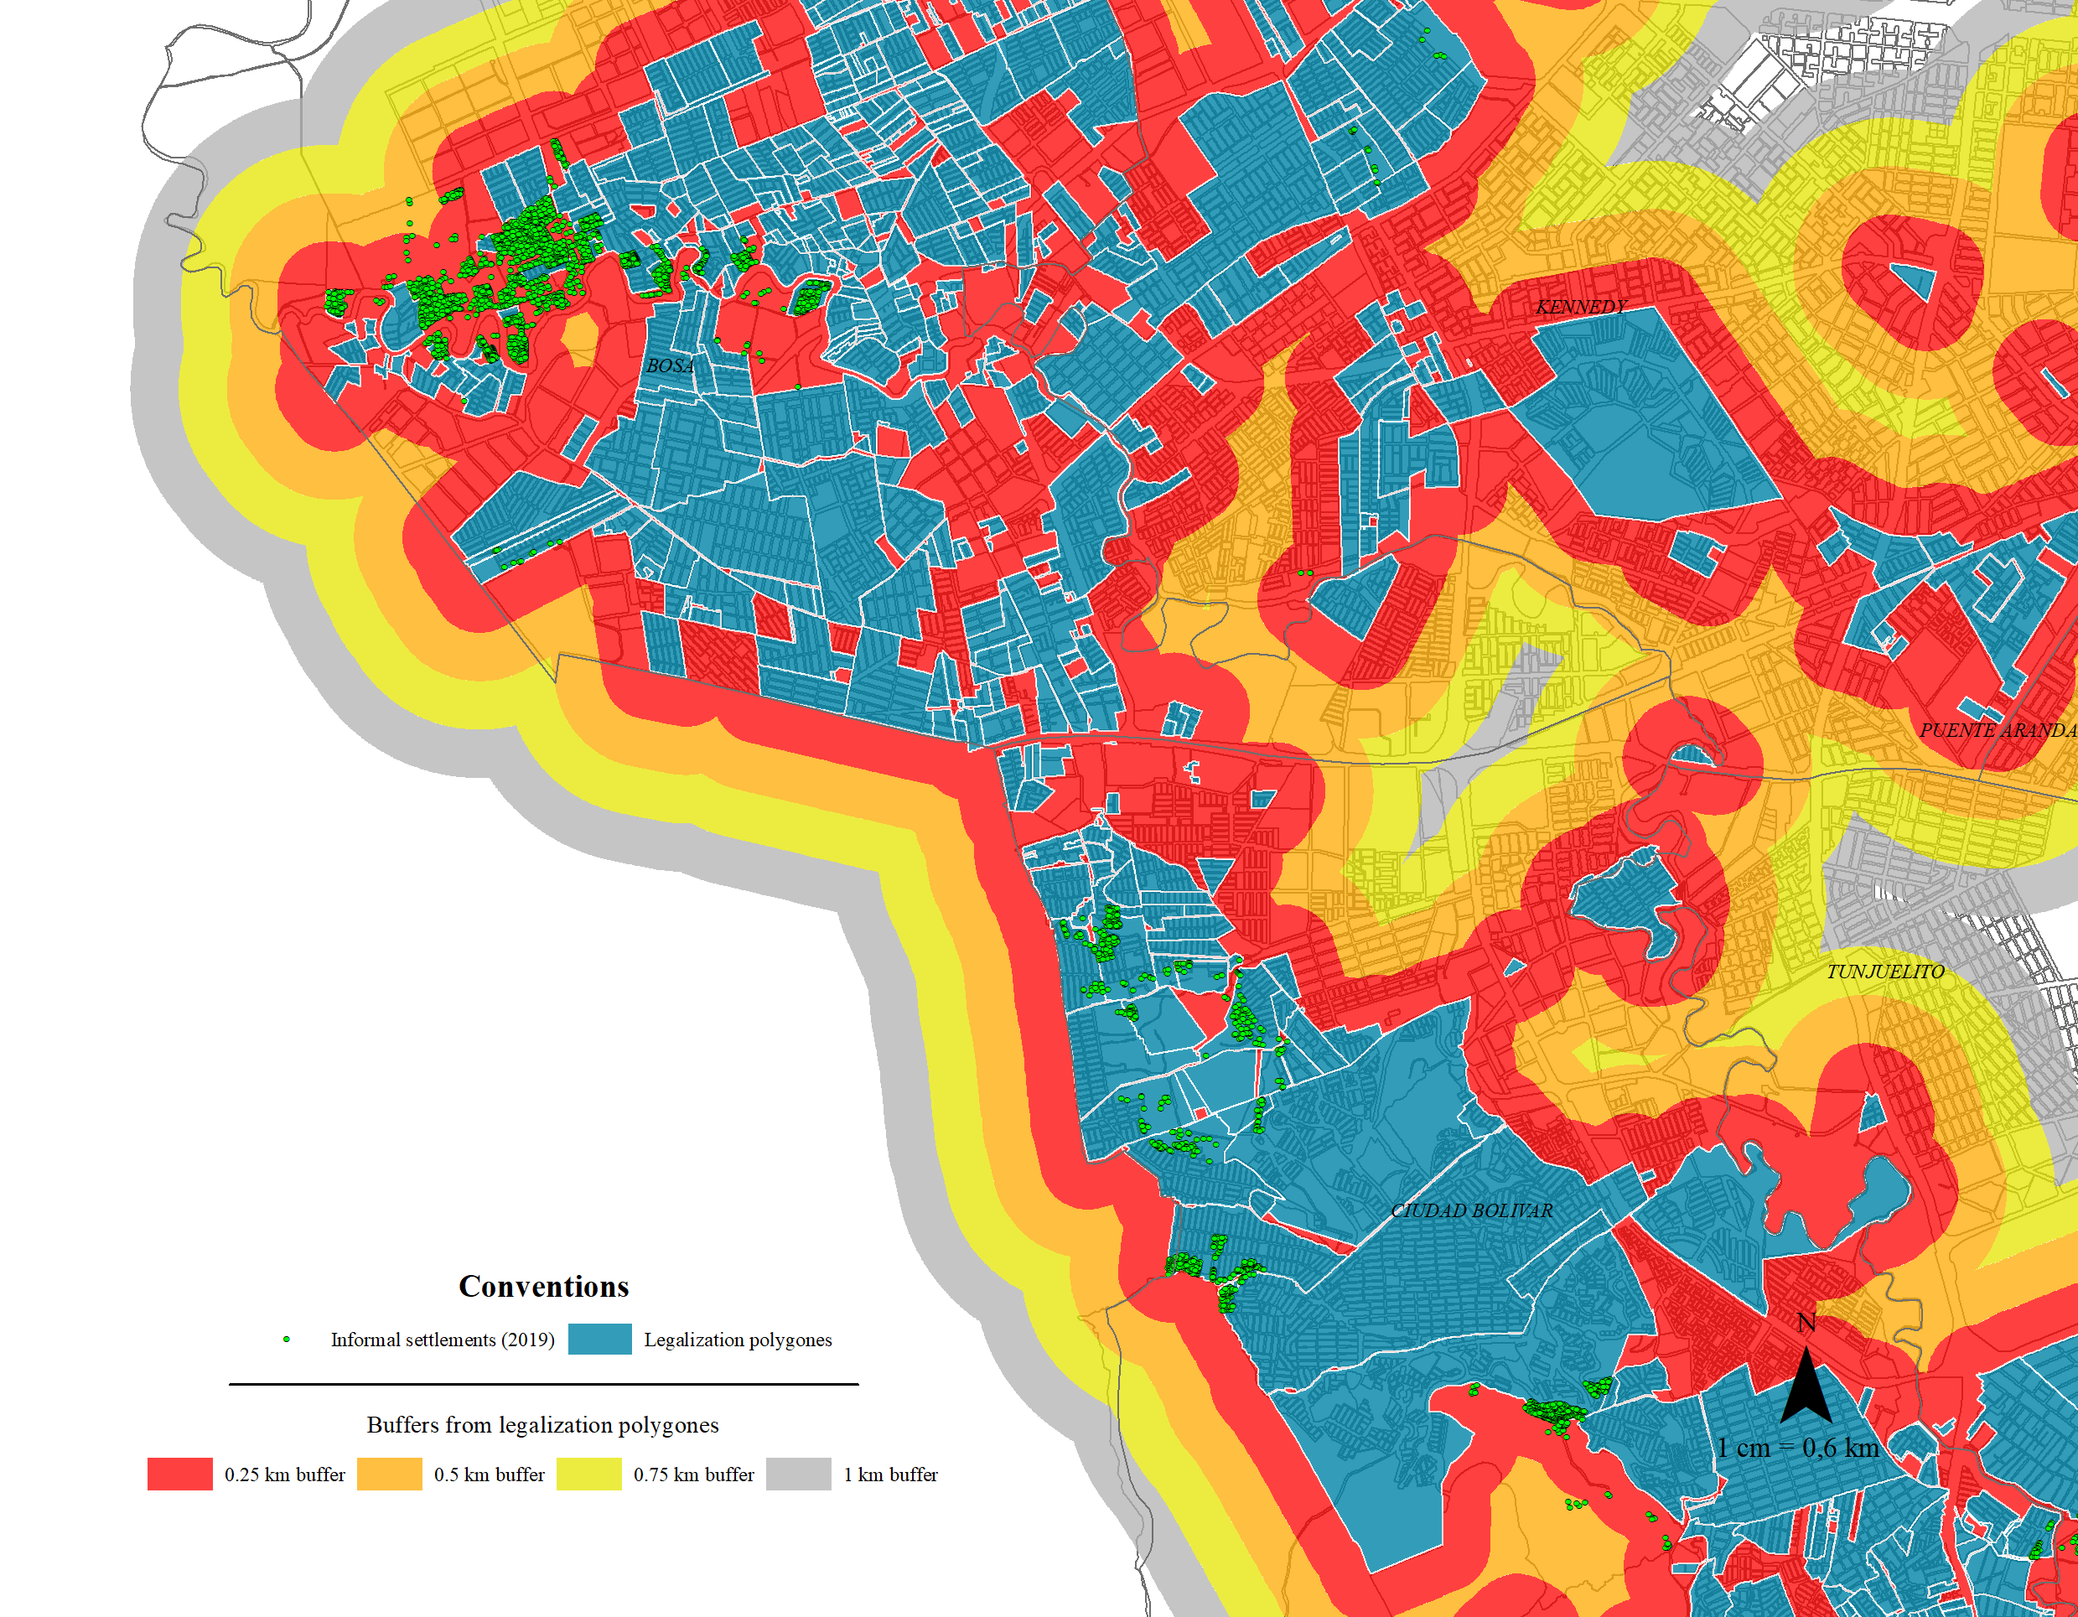


Slum recognition effects on urban informal expansion:
An impact evaluation of the Neighborhood Legalization program in Bogotá, Colombia
Universidad del Rosario, 2022
Faculty of economics
Guibor Camargo
https://github.com/Guibi1994/Neighborhood_Legalization

Slide 2
Introduction
Context:
Urban expansion is one of the most important events in South America’s recent history.
In the las three decades Bogotá almost doubled (DANE,1989,2005 and 2018), and up today is the 46th most dense urban area in the world
Habitat challenges: 3.8% of Bogota’s household are in quantitative deficit while 10.2% are in qualitative deficit (DANE 2018).
Universidad del Rosario - Faculty of Economics
Guibor Camargo

Slide 3
Introduction
Policy response:
Law 388 of 1994 (Birth of the POTs – [Es] Planes de Ordenamiento Terrotiral): Urban plans which, through programs and norms, seek to order and re-direct formal and informal urban growth.
To deal with slum’s expansion, the POTs integrated the neighborhood legalization program: recognizing illegal settlements, so they can be letter could later be provided with public infrastructure and amenities.
.Informal Settlement (construction type/origin) ≠ Illegal Settlements (legal status)
Universidad del Rosario - Faculty of Economics
Guibor Camargo

Slide 4
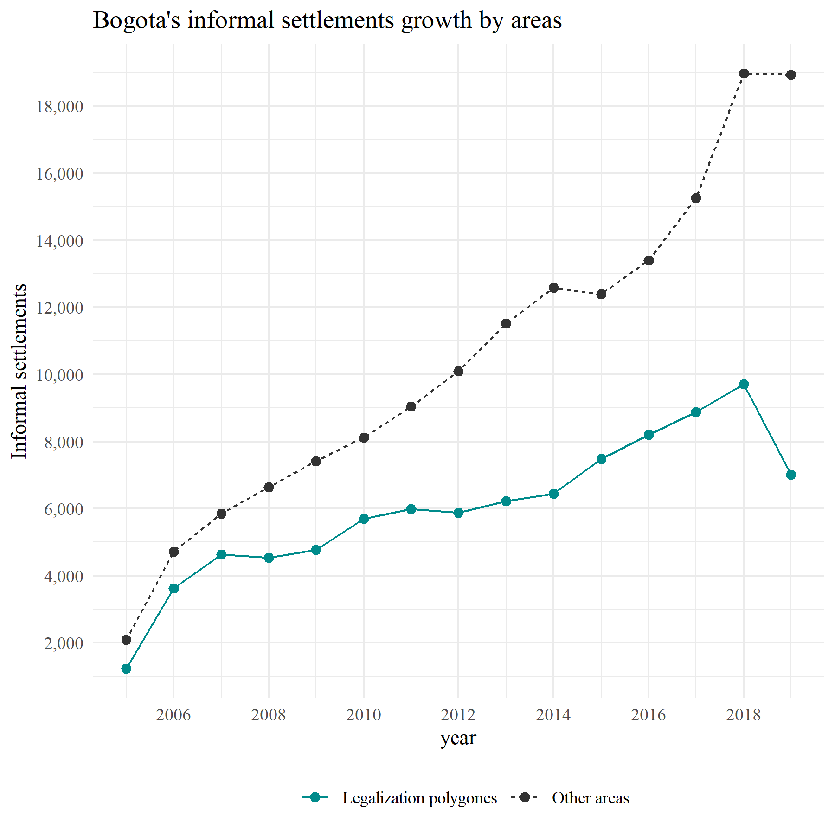
Introduction
Politicians and governments have advocated for stopping the legalization program (as well as other slum improvement-oriented policies) based on the belief that neighborhood legalization program could foster or incentive illegal and informal growth.
This vision has gained support from construction companies which build new social housing projects.
On the other hand, other have claim that this kind of program not only do not foster informal expansion but also represent a cheaper solution to the habitat problem both for the government and low-income families.
A quick first look at the data shows that the legalization of polygons seems to have had a lower informal expansion rate than the rest of the city.
Universidad del Rosario - Faculty of Economics
Guibor Camargo

Slide 5
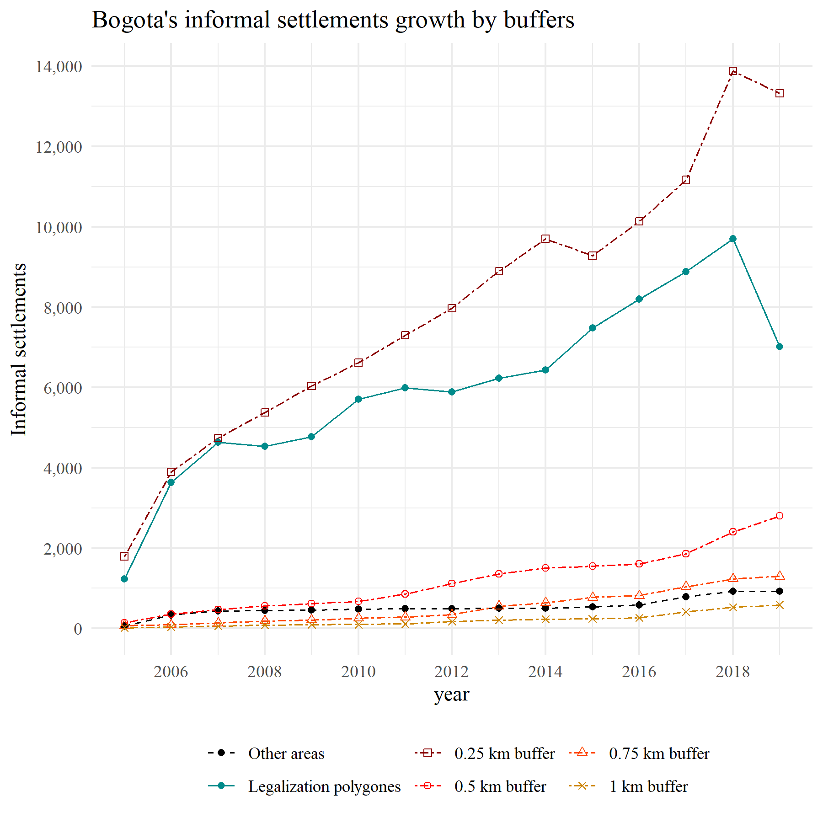
Introduction
Nevertheless, if one observes closer, it seems that the areas closer to the legalization of polygons are the ones that have experienced the faster informal occupation expansion in the last 15 years.
The research question then is ¿Have the neighborhood legalization program incentivized urban illegal expansion?
H0 = Yes but depending on the intervention’s geographic and economic context
Universidad del Rosario - Faculty of Economics
Guibor Camargo

Slide 6
Introduction
Slum intervention’s effects:
Effects over public health: Bhan, N. (2013) ; Pérez-Casas, M. (2017); Henson, R. M., et al. (2020);
Effects over household economy and unemployment: Amis, P. (2001); Takeuchi, A., Cropper, M., & Bento, A. (2008)*; Majale, M. (2008); Olthuis, K., Benni, et al. (2015); Bardhan, R.,et al. (2015)
Effects over land prices and construction: Nieto, C. A. B., et al (2017); Corredor Collazos, M. E. (2020)**.
Scientific gaps and opportunities:
Most of studies focus on physical interventions rather than legal actions.
The majority focus on positive outcomes (sometimes determinists ones), ignoring policies side effects.
Most oversimplify the policies, making risky assumptions that put in doubt causal claims.
Almost no study analyses effect heterogeneity and it’s sources
Still, impact evaluations on slum management still scarce.
Universidad del Rosario - Faculty of Economics
Guibor Camargo

Slide 7






Data
Neighborhood Legalization polygons with legal process info* (1950-2019)
Neighborhood Improvement program polygons* (2002-2019)
Resettlement Program points (2004-2019)
Informal constructions –SDH (2005-2019)
Formal constructions – ODC (2012-2019)
Census data (2005 and 2018)
Universidad del Rosario - Faculty of Economics
Guibor Camargo

Slide 8
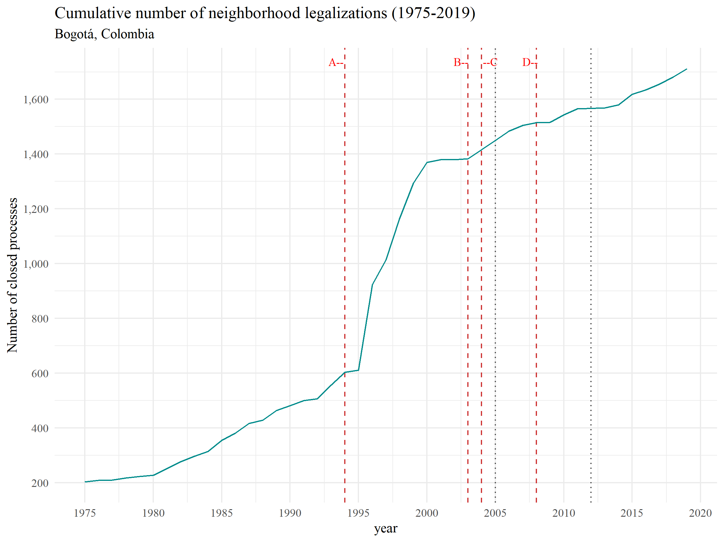
Context: the legalization program
Historical milestones:
.1994: The Law 388 gave to all municipalities the order to formulate their first POT’s.
.2003: President Alvaro Uribe Velez stablished in his Developing Plan that informal settlements which origin year were after 2003, could not be legalized nor receive any public investment. (VIS/VIP/Macro)
.2004: Bogotá finally (by decree) adopts its first POT (decree 190 of 2004).
.2008: The constitutional court declare the 2003 restriction against the constitution.
Universidad del Rosario - Faculty of Economics
Guibor Camargo

Slide 9
Context: articulation with other programs
New social housing programs
yes
Resettlement program (●)
no
“It’s on high-risk zones □?”
no
Neighborhood legalization program (□)
Lawsuit - “Tutela”
Illegal connections
“Is the settlement legal?”
District office of Habitat titling programs (●)
Public services
(aqueduct, sewerage, electricity, etc.)
“Does the settlement have available space for public infrastructure?”
Property Titling
yes
no
yes
Neighborhood improvement program (□)
Public infrastructure
(roads, parks, schools, etc.)
Regularization program (□)
Universidad del Rosario - Faculty of Economics
Guibor Camargo

Slide 10
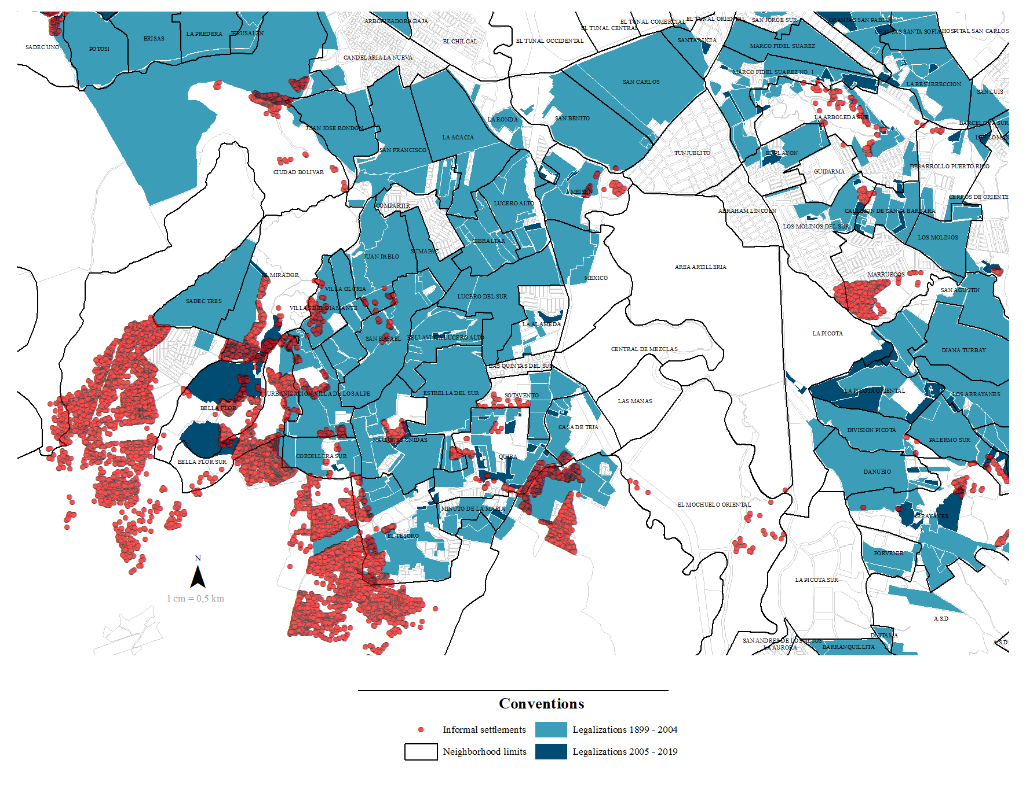
Empirical restrictions
Data restrictions:
Only illegal occupation information after 2005
Unit of analysis’s administrative complexity
Statistical concerns:
Absence of “never treated units”
Treatment anticipation
Spatial spill overs (SUTVA)
Endogeneity between treatment and outcome
Spatial partial overlap with other similar programs
Exogenous general shocks
Universidad del Rosario - Faculty of Economics
Guibor Camargo

Slide 11
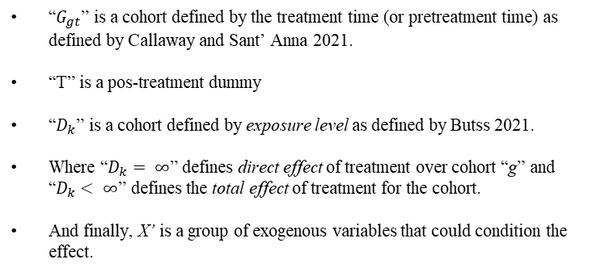




Empirical strategy
I. Probabilistic approach
$Y_{i}=Pr⁡(IO_{I}=1)$*
Unit of analysis is a standardized gomphacil unit.
Treatment and controls are defined by intersection between hexagons centroids and legalization polygons
Probability of each period is either binary, or define by a probabilistic value form a supervise classification model per year
Exposure level are defined by contiguity and distance between centroids.
10 %
40 %
25 %
20 %
Dif Dif with multiple time periods and spatial spill overs.
8 %
10 %
→
10 %
25 %
4 %
8 %
8 %
4 %
10 %
10 %
4 %
4 %
t
t+1
$$Y_{ig}= β\left(G_{gt}∗T_{gt}∗D_{k}\right)+ … +e_{i} | X_{i}^{′}$$
Treated unit in time t+1
Untreated unit in time t;t+1
“$G_{gt}$” is a cohort defined by the treatment time (or pretreatment time) as defined by Callaway and Sant’ Anna 2021.
“T” is a pos-treatment dummy
“$D_{k}$” is a cohort defined by exposure level as defined by Butss 2021.
Where “$D_{k}= ∞$” defines direct effect of treatment over cohort “g” and “$D_{k}< ∞$” defines the total effect of treatment for the cohort.
And finally, X’ is a group of exogenous variables that could condition the effect.
II. Continuous approach
$$Y_{i}=Relative IO density_{i}$$
Unit of analysis is the legalization polygon and its predefined buffers.
The outcome variable is either the number of informal ocupations (IO) or the relative density (IO_{i}/area_{i})
Exposure level are categorically defined by each buffer
Treated area (legalization polygon) in time t+1
Untreated area (buffer at ‘D’ distance) in time t;t+1
*$0≤Pr\left(IO_{i}\right)≤1$
Universidad del Rosario - Faculty of Economics
Guibor Camargo

Slide 12
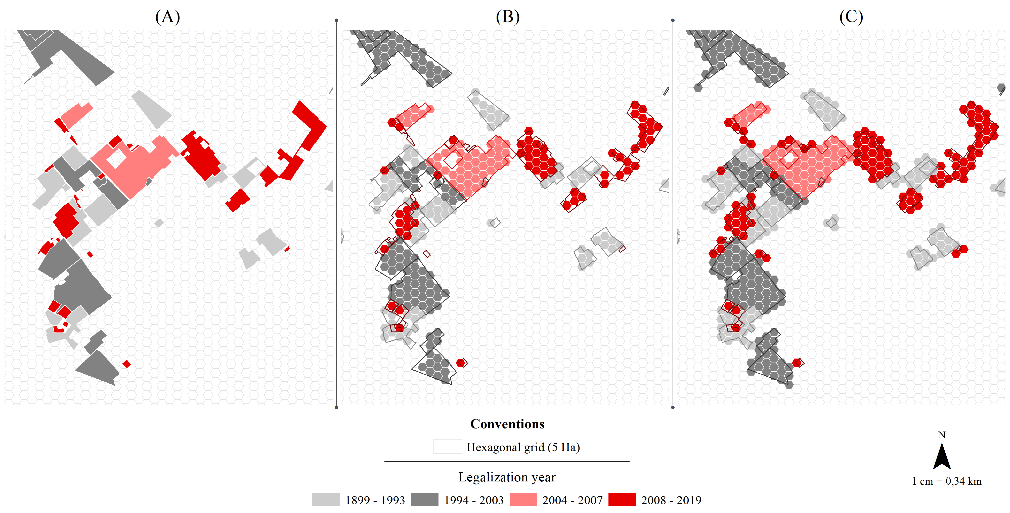
Geographic analysis: Identification of treatment status
Unit of analysis is a standardized gomphacil unit.
Treatment and controls are defined by nor by centroid intersection (B) but rather by closest centroid (C), to avoid treated unit’s omission.
Exposure level are defined by contiguity and distance between centroids.
Universidad del Rosario - Faculty of Economics
Guibor Camargo

Slide 13
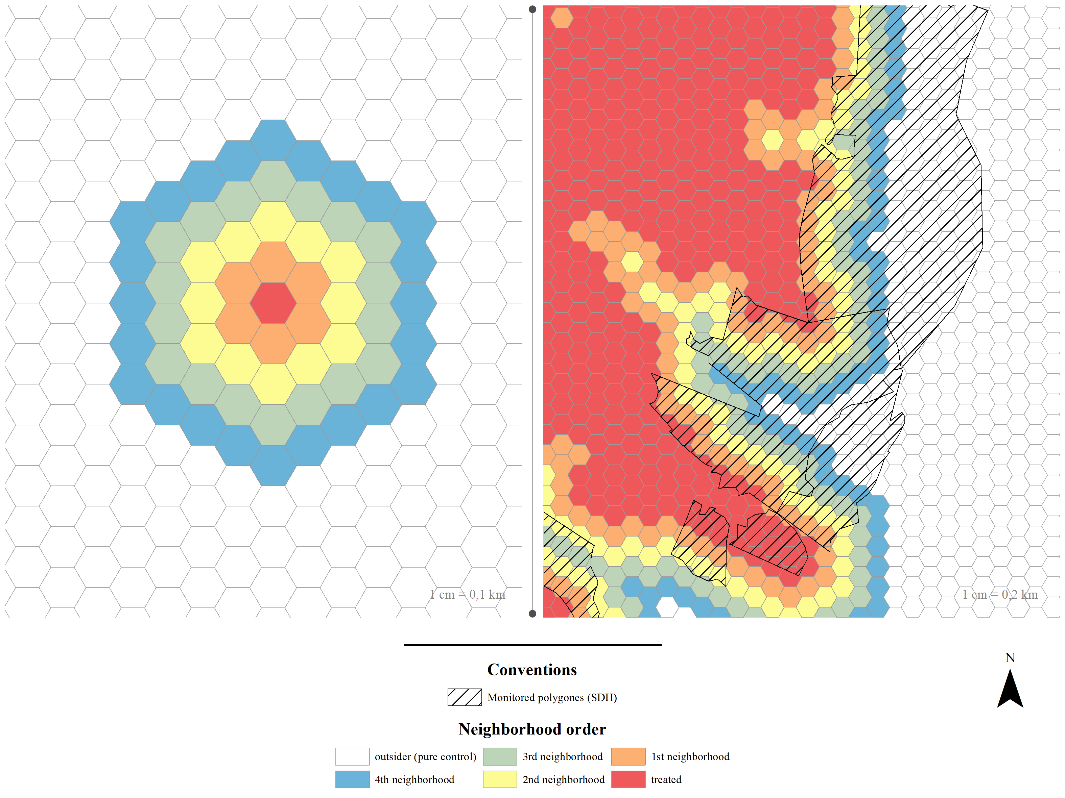
Geographic analysis: Identification of treatment status
Differentiating types of control
To latter analyze spill over effects, we divide not treated units into five (5) groups:
Pure control (outsider): >280m from treated units
First order neighbor: <80m from treated units
Second order neighbor: 80m to 140m from treated units
Third order neighbor: 140m to 210m from treated units
Fourth order neighbor: 210m to 280m from treated units
Observable units
- No all units are observable in terms of illegal occupations, only those which are inside monitoring polygons.
- This polygons vary over time, so not all observable units, are always observed during the study period.
- We only selected continuously monitored units: units that once observed, are always observed in all following periods.
Universidad del Rosario - Faculty of Economics
Guibor Camargo

Slide 14
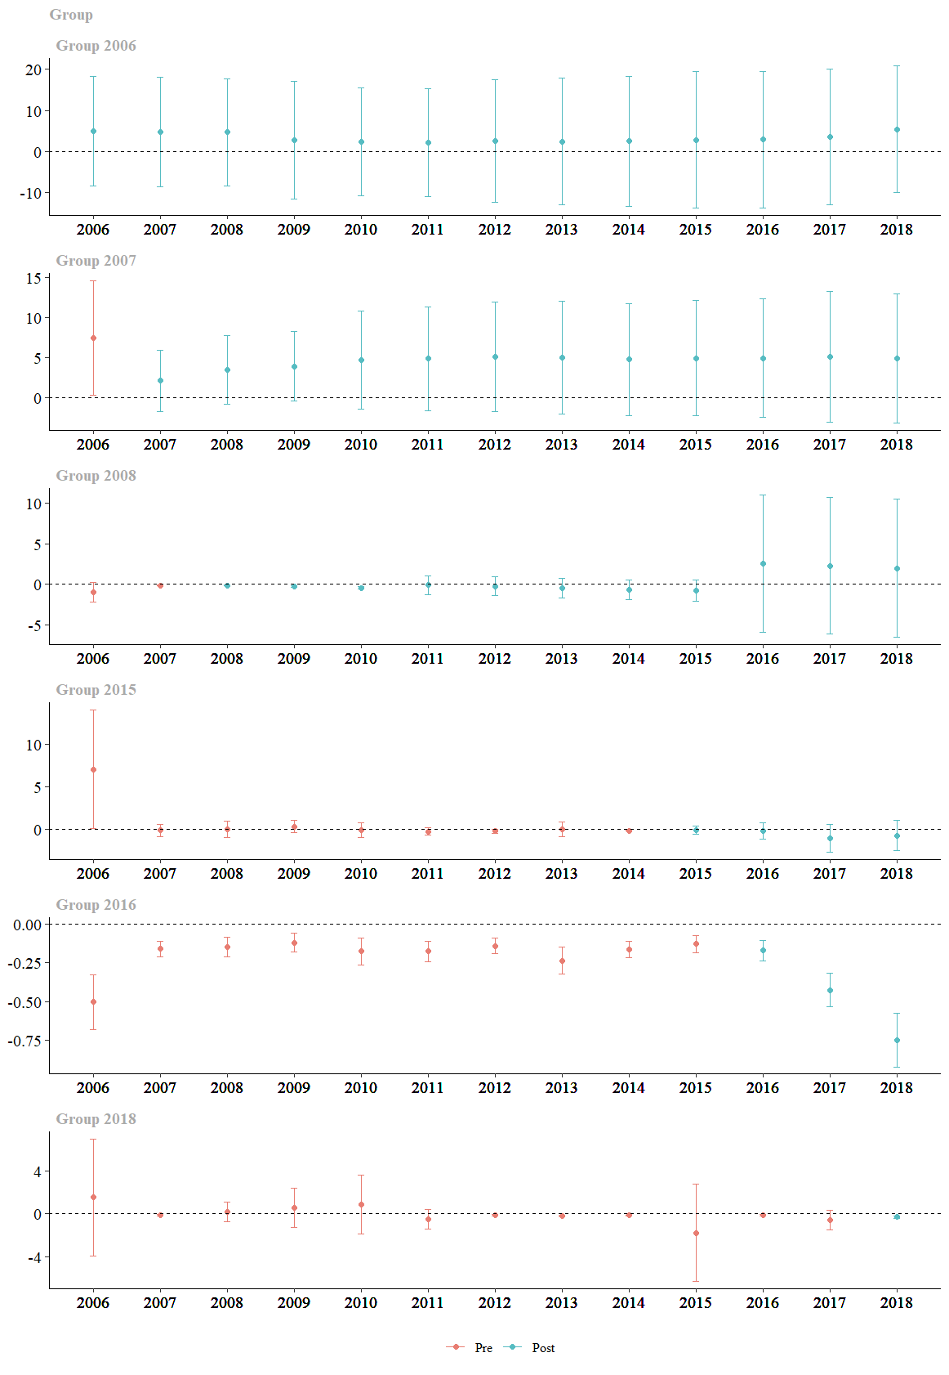
Results
R1:
- Unconditional estimation
- All controls and always monitored units
Pre-Constitutional Court Intervention
Post-Constitutional Court Intervention
Universidad del Rosario - Faculty of Economics
Guibor Camargo

Slide 15
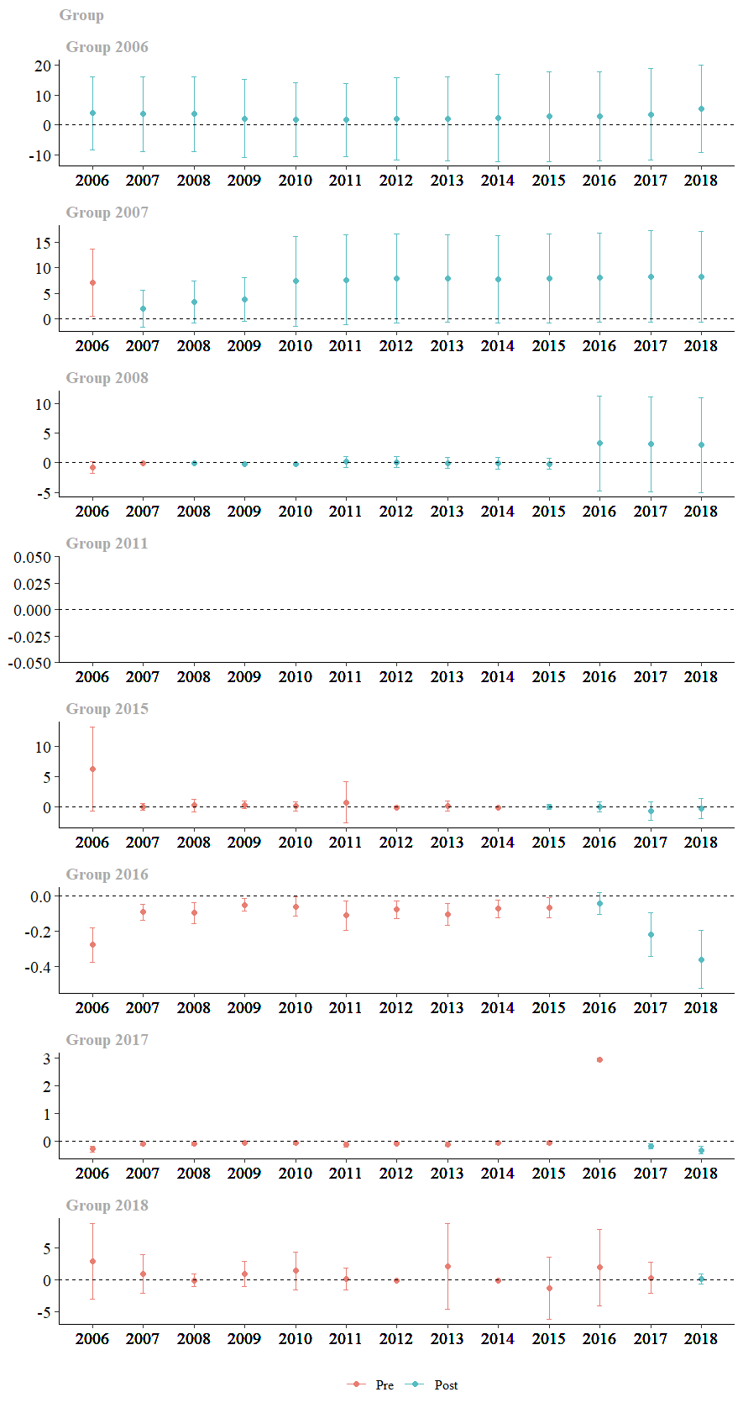
Results
R2:
- Unconditional estimation
- Only pure controls (outsiders) and always monitored units
Pre-Constitutional Court Intervention
Post-Constitutional Court Intervention
Universidad del Rosario - Faculty of Economics
Guibor Camargo

Slide 16
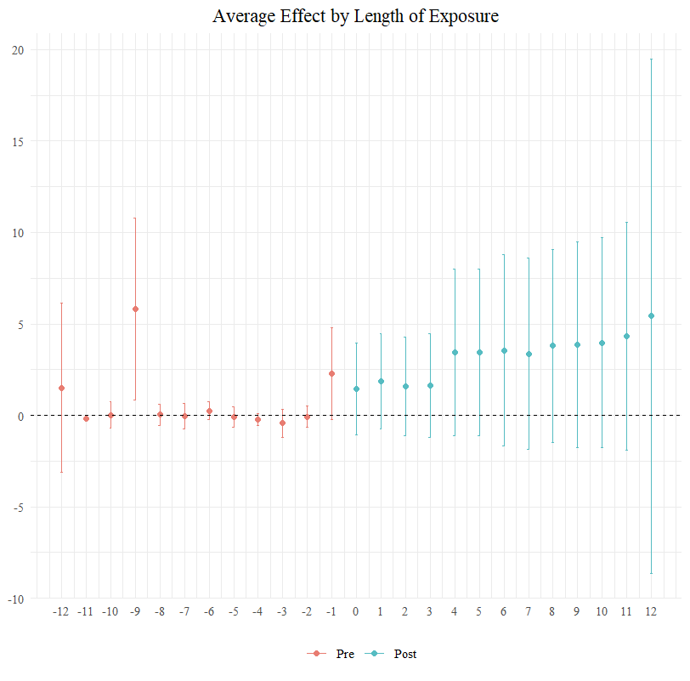
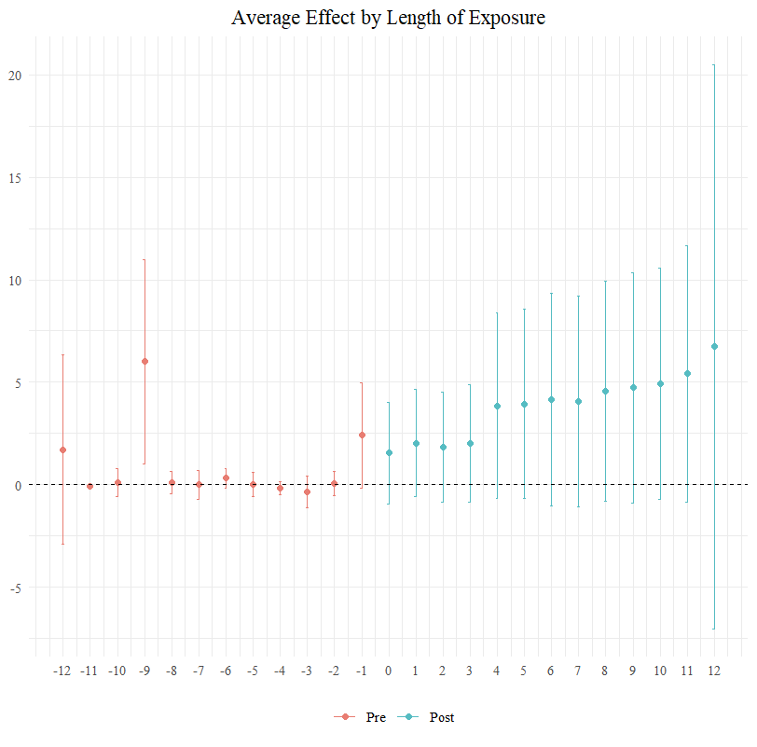
Results
R1:
- Unconditional estimation
- All controls and always monitored units
R2:
- Unconditional estimation
- Only pure controls (outsiders) and always monitored units
Universidad del Rosario - Faculty of Economics
Guibor Camargo

Slide 17
Empirical strategy
$$ATT_{1}…$$
$$ATT_{2}…$$
$$ATT_{1}…$$
$$ATT_{2}…$$
i =1
W = 0.06
i =1
i =2
W = 0.12
i =2
Distancia (W)
Distancia (W)
i =3
W = 0.25
i =3
i =4
W = 0.50
i =4
i =5
T = -2
T = -1
T = 0
T = 1
T = 2
T = 3
T = 4
i =5
2010
2011
2012
2013
2014
2015
2016
2010
2011
2012
2013
2014
2015
2016
Año previo a ser legalizado (C = 1)
Buffer de x radio
Año de legalización (T = 1 / T = 0)
Año después de legalizado (T = 1 / T = 1+t)
Universidad del Rosario - Faculty of Economics
Guibor Camargo

Slide 18
Empirical strategy
i =1
i =2
$$ATT…$$
Distancia (W)
i =3
i =1
W = 0.06
i =4
i =2
W = 0.12
Distancia (W)
i =5
i =3
W = 0.25
2010
2011
2012
2013
2014
2015
2016
i =4
$$ATT…$$
W = 0.50
i =5
T = -2
T = -1
T = 0
T = 1
T = 2
T = 3
T = 4
$$ITT…$$
2010
2011
2012
2013
2014
2015
2016
i =1
i =2
Año previo a ser legalizado (C = 1)
Año de inicio del proceso de legalización
Distancia (W)
i =3
Año de legalización (T = 1 / T = 0)
Año entre el aviso y la ejecución
i =4
Año después de legalizado (T = 1 / T = 1+t)
i =5
2010
2011
2012
2013
2014
2015
2016
Universidad del Rosario - Faculty of Economics
Guibor Camargo

Slide 19
Violación de SUTVA, geográfica y macro-teporalmente
Anticipación del tratamiento
No hay unidades “never-tretead”
Perdida del poder de comparación con el tiempo
Sin información de dependientes y covariables de la mayor parte del programa
Endogeneidad entre el tratamiento y la variable de efecto
Relación entre las variables dependientes principales y otros programas similares
Cambio en las condiciones del tratamiento (agua como derecho)
Sesgos de error de medición
i =1
i =2
i =3
i =4
i =5
2010
2011
2012
2013
2014
2015
2016
Polígono de legalización legalizado
Polígono de legalización aun no legalizado
Legalizado

